Slide 1
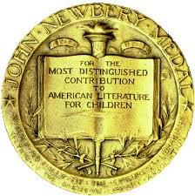
Newbery Medal Winners
1920-2016

Slide 2
What is it?
The Literary Medal given to children’s book by division of the ALA
The award is given to the author of "the most distinguished contribution to American literature for children.”
Named for John Newbery, an 18th-century English publisher of children’s bookswar
Established in 1921
Awarded annually to the author of the most
Must consider all forms of writing - fiction, non-fiction, and poetry.

Slide 3
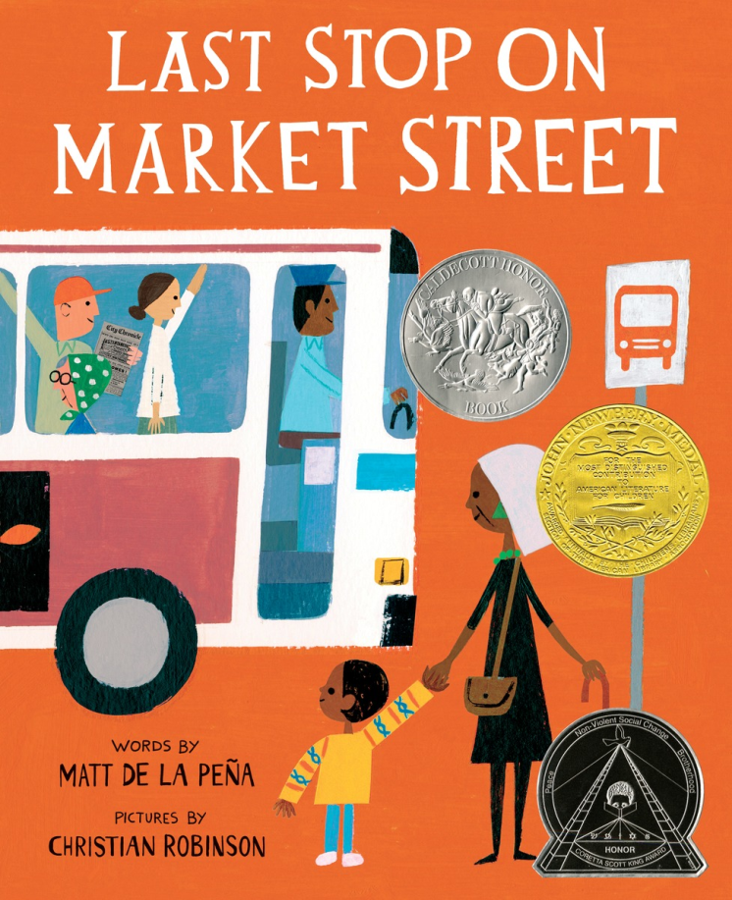
2016 Winner
Last Stop on Market Street
by Matt de la Peña
Notes:
Every Sunday after church, CJ and his grandma ride the bus across town. But today, CJ wonders why they don’t own a car like his friend Colby. Why doesn’t he have an iPod like the boys on the bus? How come they always have to get off in the dirty part of town? Each question is met with an encouraging answer from grandma, who helps him see the beauty—and fun—in their routine and the world around them.This energetic ride through a bustling city highlights the wonderful perspective only grandparent and grandchild can share, and comes to life through Matt de la Pena’s vibrant text and Christian Robinson’s radiant illustrations.

Slide 4
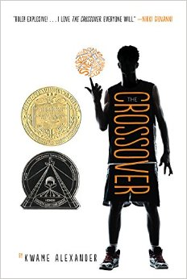
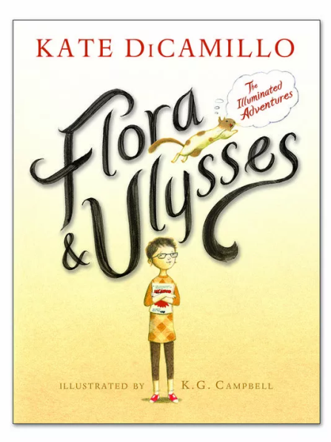
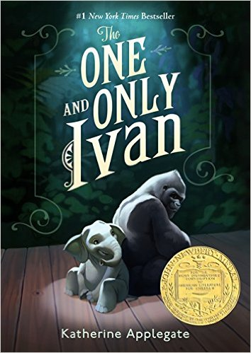
Newbery Award Winners
2015 Medal Winner: The Crossover by Kwame Alexander
2014 Medal Winner: Flora & Ulysses: The Illuminated Adventures by Kate DiCamillo
2013 Medal Winner: The One and Only Ivan by Katherine Applegate
Notes:
crossover-"With a bolt of lightning on my kicks . . .The court is SIZZLING. My sweat is DRIZZLING. Stop all that quivering. Cuz tonight I’m delivering," announces dread-locked, 12-year old Josh Bell. He and his twin brother Jordan are awesome on the court. But Josh has more than basketball in his blood, he's got mad beats, too, that tell his family's story in verse, in this fast and furious middle grade novel of family and brotherhood from Kwame Alexander.
Flora and Ulysses-Holy unanticipated occurrences! From #1 New York Times best-selling author Kate DiCamillo comes a laugh-out-loud story filled with eccentric, endearing characters — a novel interspersed with comic-style graphic sequences and full-page illustrations, all rendered in black and white by K. G. Campbell.
Ivan-Inspired by the true story of a captive gorilla known as Ivan, this illustrated book is told from the point of view of Ivan himself.
Having spent twenty-seven years behind the glass walls of his enclosure in a shopping mall, Ivan has grown accustomed to humans watching him. He hardly ever thinks about his life in the jungle. Instead, Ivan occupies himself with television, his friends Stella and Bob, and painting. But when he meets Ruby, a baby elephant taken from the wild, he is forced to see their home, and his art, through new eyes

Slide 5
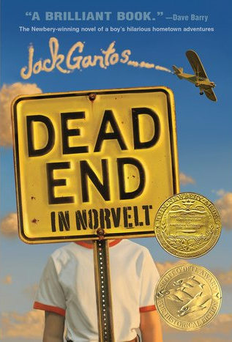
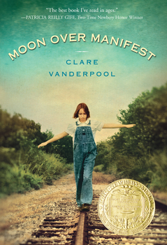
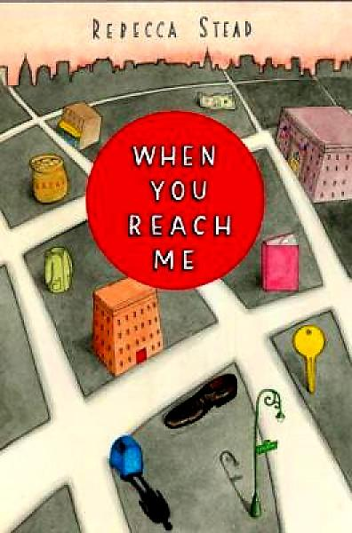
Newbery Award Winners
2012 Medal Winner: Dead End in Norvelt by Jack Gantos
2011 Medal Winner: Moon over Manifest by Clare Vanderpool
2010 Medal Winner: When You Reach Me by Rebecca Stead
Notes:
Melding the entirely true and the wildly fictional, Dead End in Norvelt is a novel about an incredible two months for a kid named Jack Gantos, whose plans for vacation excitement are shot down when he is "grounded for life" by his feuding parents, and whose nose spews bad blood at every little shock he gets. But plenty of excitement (and shocks) are coming Jack's way once his mom loans him out to help a feisty old neighbor with a most unusual chore―typewriting obituaries filled with stories about the people who founded his utopian town. As one obituary leads to another, Jack is launched on a strange adventure involving molten wax, Eleanor Roosevelt, twisted promises, a homemade airplane, Girl Scout cookies, a man on a trike, a dancing plague, voices from the past, Hells Angels . . . and possibly murder.
Moon over manifest-Abilene Tucker feels abandoned. Her father has put her on a train, sending her off to live with an old friend for the summer while he works a railroad job. Armed only with a few possessions and her list of universals, Abilene jumps off the train in Manifest, Kansas, aiming to learn about the boy her father once was. Having heard stories about Manifest, Abilene is disappointed to find that it’s just a dried-up, worn-out old town. But her disappointment quickly turns to excitement when she discovers a hidden cigar box full of mementos, including some old letters that mention a spy known as the Rattler. These mysterious letters send Abilene and her new friends, Lettie and Ruthanne, on an honest-to-goodness spy hunt, even though they are warned to “Leave Well Enough Alone.” Abilene throws all caution aside when she heads down the mysterious Path to Perdition to pay a debt to the reclusive Miss Sadie, a diviner who only tells stories from the past. It seems that Manifest’s history is full of colorful and shadowy characters—and long-held secrets. The more Abilene hears, the more determined she is to learn just what role her father played in that history. And as Manifest’s secrets are laid bare one by one, Abilene begins to weave her own story into the fabric of the town.
When you Reach me-When Miranda starts receiving mysterious notes, she doesn’t know what to do. The notes tell her that she must write a letter, a true story, and that she can’t share her mission with anyone—not even her best friend, Sal. It would be easy to ignore the strange messages, except that whoever is leaving them has an uncanny ability to predict the future. If that’s the case, then Miranda has an even bigger problem—because the notes tell her that someone is going to die, and she might be too late to stop it.

Slide 6
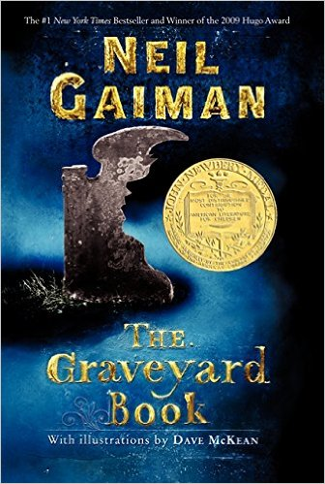
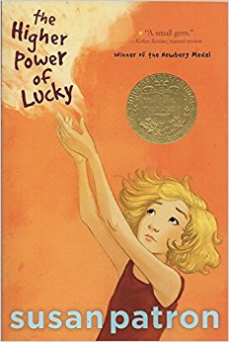
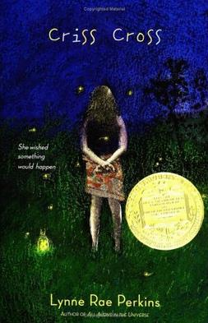
Newbery Award Winners
2009 Medal Winner: The Graveyard Book by Neil Gaiman
2007 Medal Winner: The Higher Power of Lucky by Susan Patron
2006 Medal Winner: Criss Cross by Lynne Rae Perkins
Notes:
Graveyard book-Bod is an unusual boy who inhabits an unusual place—he's the only living resident of a graveyard. Raised from infancy by the ghosts, werewolves, and other cemetery denizens, Bod has learned the antiquated customs of his guardians' time as well as their ghostly teachings—such as the ability to Fade so mere mortals cannot see him.
Can a boy raised by ghosts face the wonders and terrors of the worlds of both the living and the dead?
Higher power of Lucky-Lucky, age ten, can't wait another day. The meanness gland in her heart and the crevices full of questions in her brain make running away from Hard Pan, California (population 43), the rock-bottom only choice she has.It's all Brigitte's fault -- for wanting to go back to France. Guardians are supposed to stay put and look after girls in their care! Instead Lucky is sure that she'll be abandoned to some orphanage in Los Angeles where her beloved dog, HMS Beagle, won't be allowed. She'll have to lose her friends Miles, who lives on cookies, and Lincoln, future U.S. president (maybe) and member of the International Guild of Knot Tyers. Just as bad, she'll have to give up eavesdropping on twelve-step anonymous programs where the interesting talk is all about Higher Powers. Lucky needs her own -- and quick.
But she hadn't planned on a dust storm. Or needing to lug the world's heaviest survival-kit backpack into the desert.
Criss cross-She wished something would happen.
Something good. To her. Checking her wish for loopholes, she found one. Hoping it wasn't too late, she thought the word soon.
Meanwhile, in another part of town, he felt as if the world was opening. Life was rearranging itself; bulging in places, fraying in spots. He felt himself changing, too, but into what?
So much can happen in a summer.

Slide 7
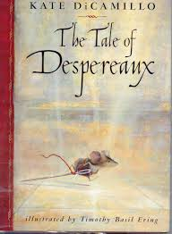
Newbery Award Winners
2005 Medal Winner: Kira-Kira by Cynthia Kadohata
2004 Medal Winner: The Tale of Despereaux by Kate DiCamillo
Notes:
Kira-Kira-glittering; shining Glittering. That's how Katie Takeshima's sister, Lynn, makes everything seem. The sky is kira-kira because its color is deep but see-through at the same time. The sea is kira-kira for the same reason. And so are people's eyes. When Katie and her family move from a Japanese community in Iowa to the Deep South of Georgia, it's Lynn who explains to her why people stop on the street to stare. And it's Lynn who, with her special way of viewing the world, teaches Katie to look beyond tomorrow. But when Lynn becomes desperately ill, and the whole family begins to fall apart, it is up to Katie to find a way to remind them all that there is always something glittering -- kira-kira -- in the future.
Welcome to the story of Despereaux Tilling, a mouse who is in love with music, stories, and a princess named Pea. It is also the story of a rat called Roscuro, who lives in the darkness and covets a world filled with light. And it is the story of Miggery Sow, a slow-witted serving girl who harbors a simple, impossible wish. These three characters are about to embark on a journey that will lead them down into a horrible dungeon, up into a glittering castle, and, ultimately, into each other's lives. What happens then?

Slide 8
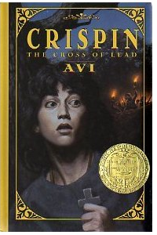
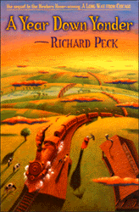
Newbery Award Winners
2003 Medal Winner: Crispin: The Cross of Lead by Avi
2002 Medal Winner: A Single Shard by Linda Sue Park
2001 Medal Winner: A Year Down Yonder by by Richard Peck
Notes:
Single Shard-set in 12th century Korea, Tree-ear, a 13-year-old orphan, lives under a bridge in Ch’ulp’o, a potters' village famed for delicate celadon ware. He has become fascinated with the potter’s craft; he wants nothing more than to watch master potter Min at work, and he dreams of making a pot of his own someday. When Min takes Tree-ear on as his helper, Tree-ear is elated — until he finds obstacles in his path: the backbreaking labor of digging and hauling clay, Min’s irascible temper, and his own ignorance. But Tree-ear is determined to prove himself — even if it means taking a long, solitary journey on foot to present Min’s work in the hope of a royal commission . . . even if it means arriving at the royal court with nothing to show but a single celadon shard.
Year down yonder-Mary Alice's childhood summers in Grandma Dowdel's sleepy Illinois town were packed with enough drama to fill the double bill of any picture show. But now she is fifteen, and faces a whole long year with Grandma, a woman well known for shaking up her neighbors-and everyone else! All Mary Alice can know for certain is this: when trying to predict how life with Grandma might turn out . . . better not. This wry, delightful sequel to the Newbery Honor Book A Long Way from Chicago has already taken its place among the classics of children's literature.

Slide 9
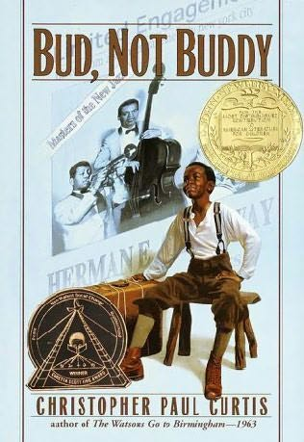
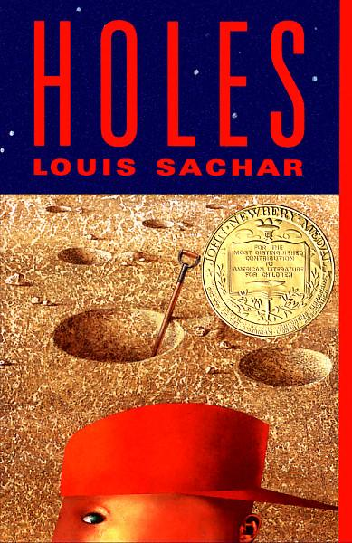
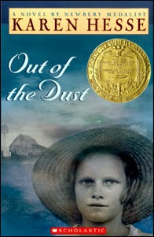
Newbery Award Winners
2000 Medal Winner: Bud, Not Buddy by Christopher Paul Curtis
1999 Medal Winner: Holes by Louis Sachar
1998 Medal Winner: Out of the Dust by Karen Hesse
Notes:
Bud, Not Buddy-It’s 1936, in Flint Michigan. Times may be hard, and ten-year-old Bud may be a motherless boy on the run, but Bud’s got a few things going for him: 1. He has his own suitcase full of special things. 2. He’s the author of Bud Caldwell’s Rules and Things for Having a Funner Life and Making a Better Liar Out of Yourself. 3. His momma never told him who his father was, but she left a clue: flyers advertising Herman E. Calloway and his famous band, the Dusky Devastators of the Depression!!!!!! Bud’s got an idea that those flyers will lead him to his father. Once he decides to hit the road to find this mystery man, nothing can stop him—not hunger, not fear, not vampires, not even Herman E. Calloway himself.
Holes-Stanley Yelnats is under a curse. A curse that began with his no-good-dirty-rotten-pig-stealing-great-great-grandfather and has since followed generations of Yelnatses. Now Stanley has been unjustly sent to a boys’ detention center, Camp Green Lake, where the boys build character by spending all day, every day digging holes exactly five feet wide and five feet deep. There is no lake at Camp Green Lake. But there are an awful lot of holes.
It doesn’t take long for Stanley to realize there’s more than character improvement going on at Camp Green Lake. The boys are digging holes because the warden is looking for something. But what could be buried under a dried-up lake? Stanley tries to dig up the truth in this inventive and darkly humorous tale of crime and punishment—and redemption.
Out of the dust-This gripping story, written in sparse first-person, free-verse poems, is the compelling tale of Billie Jo's struggle to survive during the dust bowl years of the Depression. With stoic courage, she learns to cope with the loss of her mother and her grieving father's slow deterioration. There is hope at the end when Billie Jo's badly burned hands are healed, and she is able to play her beloved piano again.

