Slide 1
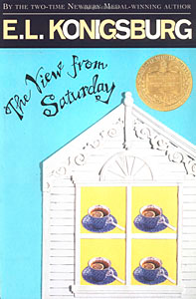
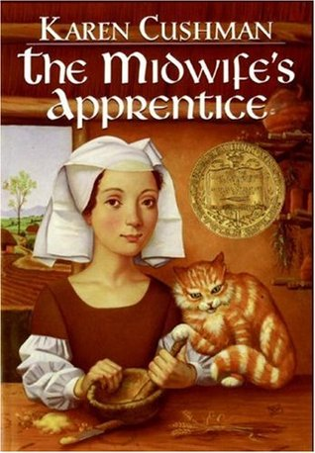
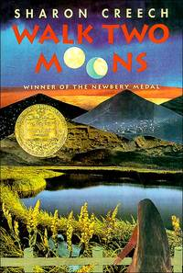
Newbery Award Winners
1997 Medal Winner: The View from Saturday by E.L. Konigsburg
1996 Medal Winner: The Midwife's Apprentice by Karen Cushman
1995 Medal Winner: Walk Two Moons by Sharon Creech
Notes:
The View-HOW HAD MRS. OLINSKI CHOSEN her sixth-grade Academic Bowl team? She had a number of answers. But were any of them true? How had she really chosen Noah and Nadia and Ethan and Julian? And why did they make such a good team? It was a surprise to a lot of people when Mrs. Olinski's team won the sixth-grade Academic Bowl contest at Epiphany Middle School. It was an even bigger surprise when they beat the seventh grade and the eighth grade, too. And when they went on to even greater victories, everyone began to ask: How did it happen?
Midwife’s app-set in medieval England. The girl known only as Brat has no family, no home, and no future until she meets Jane the Midwife and becomes her apprentice. As she helps the sharp-tempered Jane deliver babies, Brat--who renames herself Alyce--gains knowledge, confidence, and the courage to want something from life: "A full belly, a contented heart, and a place in this world.“
Walk two moons-Thirteen-year-old Salamanca Tree Hiddle, proud of her country roots and the "Indian-ness in her blood," travels from Ohio to Idaho with her eccentric grandparents. Along the way, she tells them of the story of Phoebe Winterbottom, who received mysterious messages, who met a "potential lunatic," and whose mother disappeared.
As Sal entertains her grandparents with Phoebe's outrageous story, her own story begins to unfold—the story of a thirteen-year-old girl whose only wish is to be reunited with her missing mother.

Slide 2
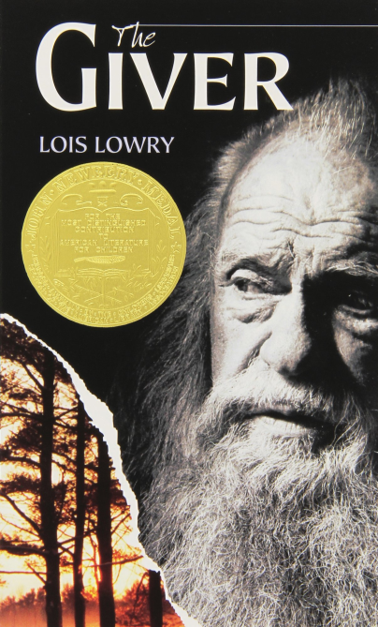
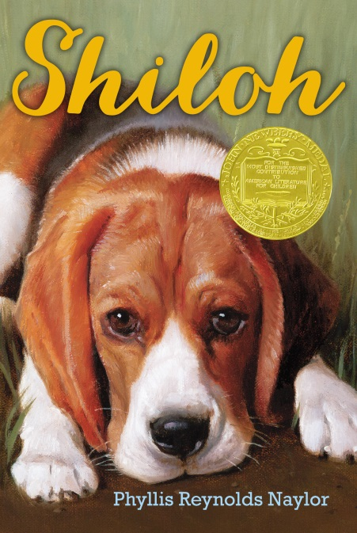
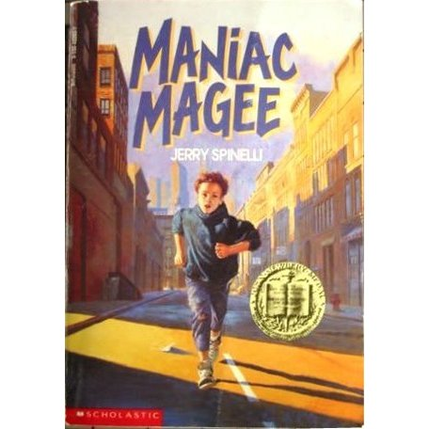
Newbery Award Winners
1994 Medal Winner: The Giver by Lois Lowry
1992 Medal Winner: Shiloh by Phyllis Reynolds Naylor
1991 Medal Winner: Maniac Magee by Jerry Spinelli
Notes:
The Giver-The Giver, the 1994 Newbery Medal winner, has become one of the most influential novels of our time. The haunting story centers on twelve-year-old Jonas, who lives in a seemingly ideal, if colorless, world of conformity and contentment. Not until he is given his life assignment as the Receiver of Memory does he begin to understand the dark, complex secrets behind his fragile community
Shiloh-When Marty Preston comes across a young beagle in the hills behind his home, it's love at first sight—and also big trouble. It turns out the dog, which Marty names Shiloh, belongs to Judd Travers, who drinks too much and has a gun—and abuses his dogs. So when Shiloh runs away from Judd to Marty, Marty just has to hide him and protect him from Judd. But Marty's secret becomes too big for him to keep to himself, and it exposes his entire family to Judd's anger. How far will Marty have to go to make Shiloh his?
Maniac Magee-Jeffrey Lionel "Maniac" Magee might have lived a normal life if a freak accident hadn't made him an orphan. After living with his unhappy and uptight aunt and uncle for eight years, he decides to run--and not just run away, but run. This is where the myth of Maniac Magee begins, as he changes the lives of a racially divided small town with his amazing and legendary feats.

Slide 3
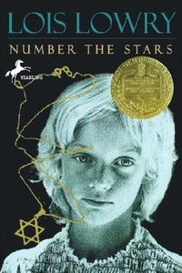
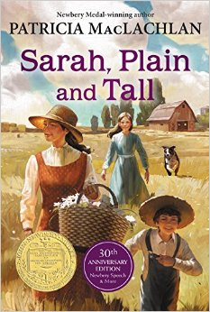
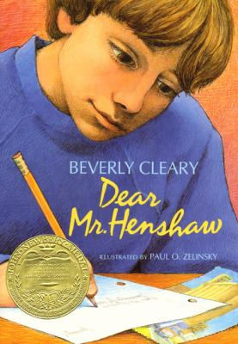
Newbery Award Winners
1990 Medal Winner: Number the Stars by Lois Lowry
1986 Medal Winner: Sarah, Plain and Tall by Patricia MacLachlan
1984 Medal Winner: Dear Mr. Henshaw by Beverly Cleary
Notes:
Number the Stars-As the German troops begin their campaign to "relocate" all the Jews of Denmark, Annemarie Johansen’s family takes in Annemarie’s best friend, Ellen Rosen, and conceals her as part of the family.
Through the eyes of ten-year-old Annemarie, we watch as the Danish Resistance smuggles almost the entire Jewish population of Denmark, nearly seven thousand people, across the sea to Sweden. The heroism of an entire nation reminds us that there was pride and human decency in the world even during a time of terror and war
Sarah-Set in the late nineteenth century and told from young Anna's point of view, Sarah, Plain and Tall tells the story of how Sarah Elisabeth Wheaton comes from Maine to the prairie to answer Papa's advertisement for a wife and mother. Before Sarah arrives, Anna and her younger brother, Caleb, wait and wonder. Will Sarah be nice? Will she sing? Will she stay?
Mr. Henshaw-After his parents separate, Leigh Botts moves to a new town with his mother. Struggling to make friends and deal with his anger toward his absent father, Leigh loses himself in a class assignment in which he must write to his favorite author. When Mr. Henshaw responds, the two form an unexpected friendship that will change Leigh’s life forever.

Slide 4
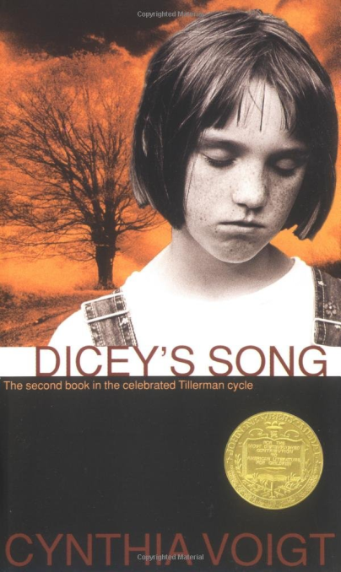
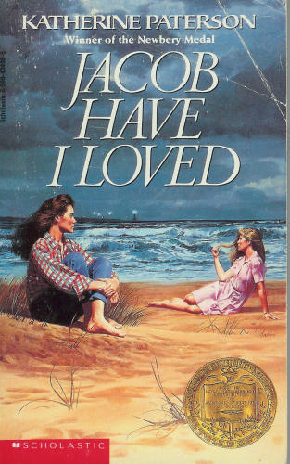
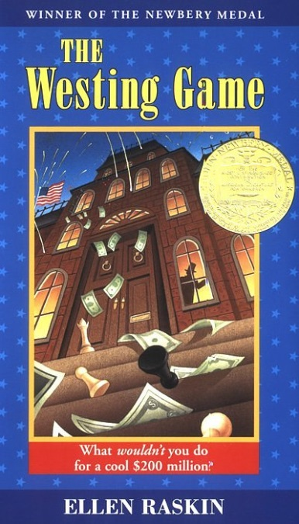
Newbery Award Winners
1983 Medal Winner: Dicey's Song by Cynthia Voigt
1981 Medal Winner: Jacob Have I Loved by Katherine Paterson
1979 Medal Winner: The Westing Game by Ellen Raskin
Notes:
Dicey’s song-When Momma abandoned Dicey Tillerman and her three siblings in a mall parking lot and was later traced to an asylum where she lay unrecognizing, unknowing, she left her four children no choice but to get on by themselves. They set off alone on foot over hundreds of miles until they finally found someone to take them in. Gram’s rundown farm isn’t perfect, but they can stay together as a family—which is all Dicey really wanted. But after watching over the others for so long, it’s hard for Dicey to know what to do now. Her own identity has been so wrapped up in being the caretaker, navigator, penny counter, and decision maker that she’s not sure how to let go of some responsibilities while still keeping a sense of herself. But when the past comes back with devastating force, Dicey sees just how necessary—and painful—letting go can be.
Jacob-Sara Louise Bradshaw is sick and tired of her beautiful twin Caroline. Ever since they were born, Caroline has been the pretty one, the talented one, the better sister. Even now, Caroline seems to take everything: Louise's friends, their parents' love, her dreams for the future.
For once in her life, Louise wants to be the special one. But in order to do that, she must first figure out who she is . . . and find a way to make a place for herself outside her sister's shadow.
Westing Game-A bizarre chain of events begins when sixteen unlikely people gather for the reading of Samuel W. Westing’s will. And though no one knows why the eccentric, game-loving millionaire has chosen a virtual stranger—and a possible murderer—to inherit his vast fortune, on things for sure: Sam Westing may be dead…but that won’t stop him from playing one last game!

Slide 5
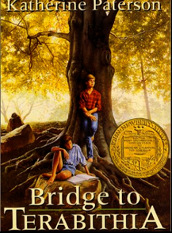
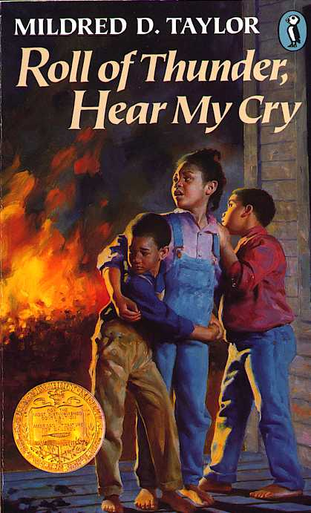
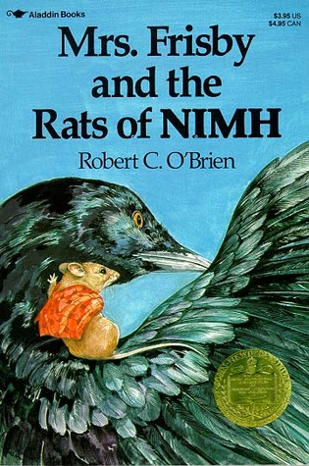
Newbery Award Winners
1978 Medal Winner: Bridge to Terabithia by Katherine Paterson
1977 Medal Winner: Roll of Thunder, Hear My Cry by Mildred D. Taylor
1972 Medal Winner: Mrs. Frisby and the Rats of NIMH by Robert C. O'Brien
Notes:
Bridge- Jess Aarons has been practicing all summer so he can be the fastest runner in the fifth grade. And he almost is, until the new girl in school, Leslie Burke, outpaces him. The two become fast friends and spend most days in the woods behind Leslie's house, where they invent an enchanted land called Terabithia. One morning, Leslie goes to Terabithia without Jess and a tragedy occurs. It will take the love of his family and the strength that Leslie has given him for Jess to be able to deal with his grief
Roll of Thunder-Set in Mississippi at the height of the Depression, this is the story of one family's struggle to maintain their integrity, pride, and independence in the face of racism and social injustice. And it is also Cassie's story—Cassie Logan, an independent girl who discovers over the course of an important year why having land of their own is so crucial to the Logan family, even as she learns to draw strength from her own sense of dignity and self-respect
NIMH-Mrs. Frisby, a widowed mouse with four small children, is faced with a terrible problem. She must move her family to their summer quarters immediately, or face almost certain death. But her youngest son, Timothy, lies ill with pneumonia and must not be moved. Fortunately, she encounters the rats of NIMH, an extraordinary breed of highly intelligent creatures, who come up with a brilliant solution to her dilemma. And Mrs. Frisby in turn renders them a great service.

Slide 6
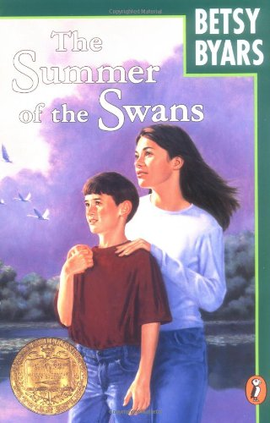
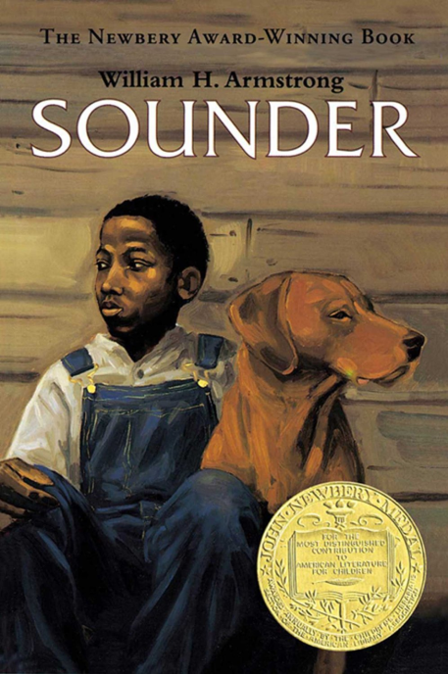
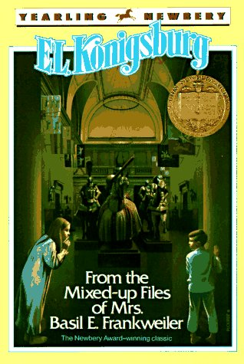
Newbery Award Winners
1971 Medal Winner: Summer of the Swans by Betsy Byars
1970 Medal Winner: Sounder by William H. Armstrong
1968 Medal Winner: From the Mixed-Up Files of Mrs. Basil E. Frankweiler by E. L. Konigsburg
Notes:
Swans- All summer Sara Godfrey has fretted over herself, her impossible body, her terrible new haircut. One moment she's elated, the next, she's in tears. And she can't figure out why. Maybe her wildly changing moods are tied to the sudden and unaccountable appearance of the swans, which hold the rapt attention of Charlie, Sara's mentally handicapped brother, who she loves far more than herself these days. In fact, it will be the sudden disappearance of Charlie that will compel Sara to abandon her own small, annoying miseries, and lose herself in searching for him. In her anguish, Sara turns to Joe Melby, whom she has long despised, and together they search through the dense woods and rough fields to find him. Sara knows that she will never be the same again
Sounder=During the difficult years of the nineteenth century South, an African American boy and his poor family rarely have enough to eat. Each night, the boy's father takes their dog, Sounder, out to look for food and the man grows more desperate by the day.
When food suddenly appears on the table one morning, it seems like a blessing. But the sheriff and his deputies are not far behind. The ever-loyal Sounder remains determined to help the family he loves as hard times bear down on them.
Mixed up files: When suburban Claudia Kincaid decides to run away, she knows she doesn't just want to run from somewhere, she wants to run to somewhere -- to a place that is comfortable, beautiful, and, preferably, elegant. She chooses the Metropolitan Museum of Art in New York City. Knowing that her younger brother Jamie has money and thus can help her with a serious cash-flow problem, she invites him along. Once settled into the museum, Claudia and Jamie find themselves caught up in the mystery of an angel statue that the museum purchased at auction for a bargain price of $225. The statue is possibly an early work of the Renaissance master, Michelangelo, and therefore worth millions. Is it? Or isn't it? Claudia is determined to find out. Her quest leads her to Mrs. Basil E. Frankweiler, the remarkable old woman who sold the statue, and to some equally remarkable discoveries about herself

Slide 7
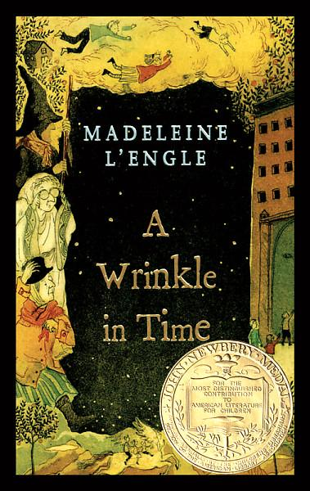
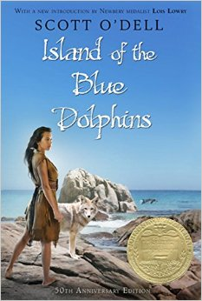
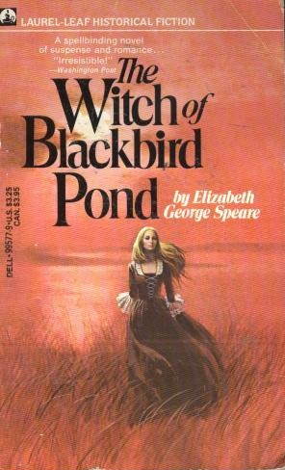
Newbery Award Winners
1963 Medal Winner: A Wrinkle in Time by Madeleine L'Engle
1961 Medal Winner: Island of the Blue Dolphins by Scott O'Dell
1959 Medal Winner: The Witch of Blackbird Pond by Elizabeth George Speare
Notes:
Wrinkle in Time-It was a dark and stormy night; Meg Murry, her small brother Charles Wallace, and her mother had come down to the kitchen for a midnight snack when they were upset by the arrival of a most disturbing stranger.
"Wild nights are my glory," the unearthly stranger told them. "I just got caught in a downdraft and blown off course. Let me sit down for a moment, and then I'll be on my way. Speaking of ways, by the way, there is such a thing as a tesseract."
A tesseract (in case the reader doesn't know) is a wrinkle in time. To tell more would rob the reader of the enjoyment of Miss L'Engle's unusual book. A Wrinkle in Time, winner of the Newbery Medal in 1963, is the story of the adventures in space and time of Meg, Charles Wallace, and Calvin O'Keefe (athlete, student, and one of the most popular boys in high school). They are in search of Meg's father, a scientist who disappeared while engaged in secret work for the government on the tesseract problem.
In the Pacific there is an island that looks like a big fish sunning itself in the sea. Around it, blue dolphins swim, otters play, and sea elephants and sea birds abound. once, Indians also lived on the island. And when they left and sailed to the east, one young girl was left behind. Blue dolphins-This is the story of Karana, the Indian girl who lived alone for years on the Island of the Blue Dolphins. Year after year, she watched one season pass into another and waited for a ship to take her away. But while she waited, she kept herself alive by building shelter, making weapons, finding food, and fighting her enemies, the wild dogs. It is not only an unusual adventure of survival, but also a tale of natural beauty and personal discovery.
Witch-Sixteen-year-old Kit Tyler is marked by suspicion and disapproval from the moment she arrives on the unfamiliar shores of colonial Connecticut in 1687. Alone and desperate, she has been forced to leave her beloved home on the island of Barbados and join a family she has never met. Torn between her quest for belonging and her desire to be true to herself, Kit struggles to survive in a hostile place. Just when it seems she must give up, she finds a kindred spirit. But Kit’s friendship with Hannah Tupper, believed by the colonists to be a witch, proves more taboo than she could have imagined and ultimately forces Kit to choose between her heart and her duty.

Slide 8
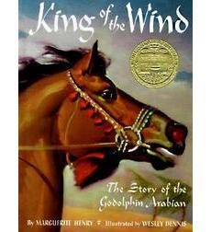
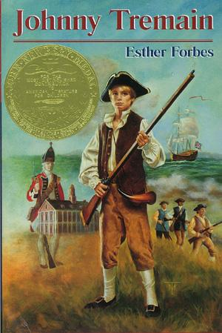
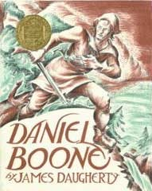
Newbery Award Winners
1949 Medal Winner: King of the Wind by Marguerite Henry
1944 Medal Winner: Johnny Tremain by Esther Forbes
1940 Medal Winner: Daniel Boone by James Daugherty
Notes:
King of the Wind- He was named "Sham" for the sun, this golden-red stallion born in the Sultan of Morocco's stone stables. Upon his heel was a small white spot, the symbol of speed. But on his chest was the symbol of misfortune. Although he was swift as the desert winds, Sham's pedigree would be scorned all his life by cruel masters and owners. This is the classic story of Sham and his friend, the stable boy Agba. their adventures take them from the sands of the Sahara. to the royal courts of France, and finally to the green pastures and stately homes of England. For Sham was the renowned Godolphin Arabian, whose blood flows through the veins of almost very superior thoroughbred. Sham's speed -- like his story -- has become legendary.
Johnny Tremain, winner of the 1944 Newbery Medal, is one of the finest historical novels ever written for children. As compelling today as it was seventy years ago, to read this riveting novel is to live through the defining events leading up to the American Revolutionary War. Fourteen-year-old Johnny Tremain, an apprentice silversmith with a bright future ahead of him, injures his hand in a tragic accident, forcing him to look for other work. In his new job as a horse-boy, riding for the patriotic newspaper, The Boston Observer, and as a messenger for the Sons of Liberty, he encounters John Hancock, Samuel Adams, and Dr. Joseph Warren. Soon Johnny is involved in the pivotal events shaping the American Revolution from the Boston Tea Party to the first shots fired at Lexington

Slide 9
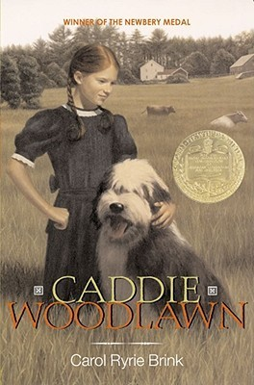
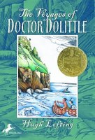
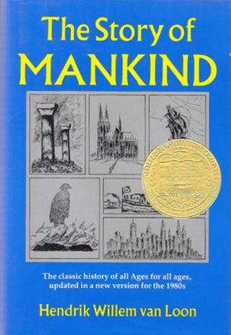
Newbery Award Winners
1936 Medal Winner: Caddie Woodlawn by Carol Ryrie Brink
1923 Medal Winner: The Voyages of Doctor Dolittle by Hugh Lofting
1922 Medal Winner: The Story of Mankind by Hendrik Willem van Loon
Notes:
Caddie Woodlawn is a real adventurer. She'd rather hunt than sew and plow than bake, and tries to beat her brother's dares every chance she gets. Caddie is friends with Indians, who scare most of the neighbors -- neighbors who, like her mother and sisters, don't understand her at all. Caddie is brave, and her story is special because it's based on the life and memories of Carol Ryrie Brink's grandmother, the real Caddie Woodlawn. Her spirit and sense of fun have made this book a classic that readers have taken to their hearts for more than seventy years.
Doctor Dolittle heads for the high seas in perhaps the most amazing adventure ever experienced by man or animal! Told by 9-and-a-half-year-old Tommy Stubbins, crewman and future naturalist, Doctor Dolittle and company survive a perilous shipwreck and land on the mysterious, floating Spidermonkey Island. There he meets the Great Glass Sea Snail who holds the key to the biggest mystery of all.
The Story of Mankind was written and illustrated by Dutch-American journalist, professor, and author Hendrik Willem van Loon and published in 1921. In 1922, it was the first book to be awarded the Newbery Medal for an outstanding contribution to children's literature. Written for his children (Hansje and Willem), The Story of Mankind tells in brief chapters the history of western civilization beginning with primitive man, covering the development of writing, art, and architecture, the rise of major religions, and the formation of the modern nation-state. Van Loon explains in the book how he selected what and what not to include by subjecting all materials to the question: Did the person or event in question perform an act without which the entire history of civilization would have been different? After its first edition, Van Loon had another edition published later in the 1920s which included an extra essay, called "After Seven Years" about the effects of World War I.

