Slide 1
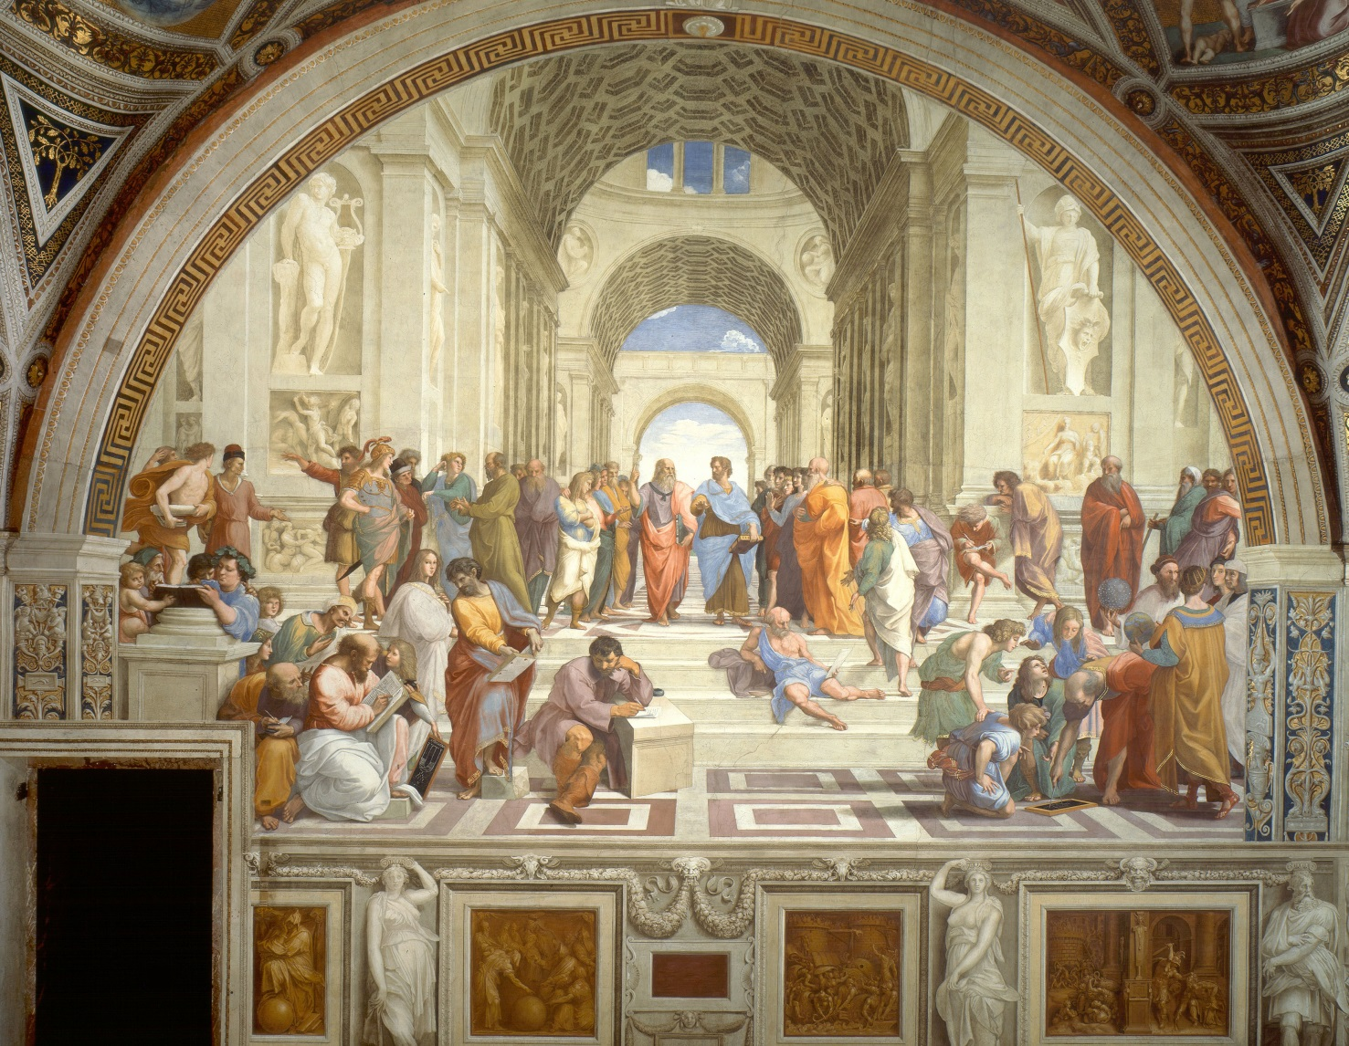
School of Athens--Raphael

Slide 2
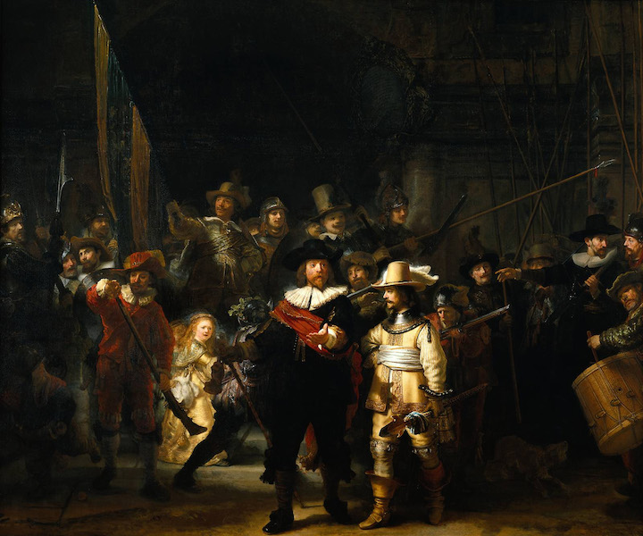
The Night Watch--Rembrandt

Slide 3
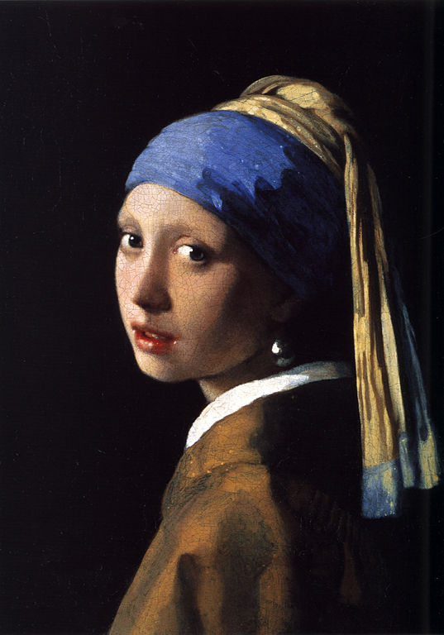
Vermeer— Girl with the Pearl Earring

Slide 4
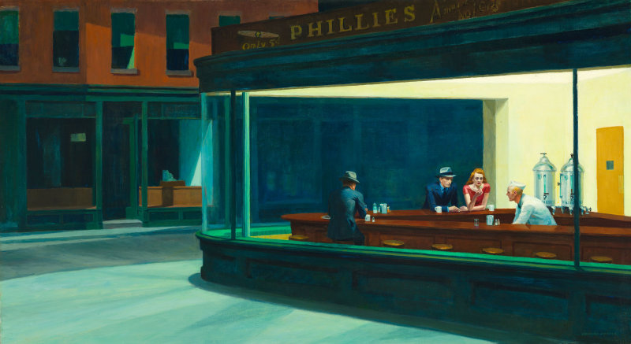
Edward Hopper--Nighthawks

Slide 5
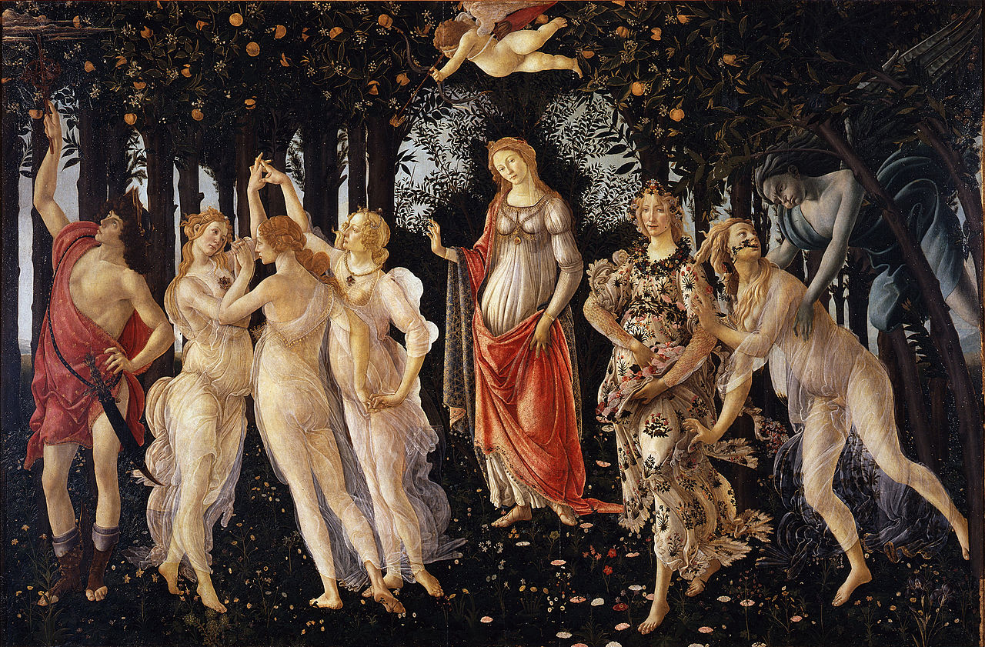
Primavera--Botticelli

Slide 6
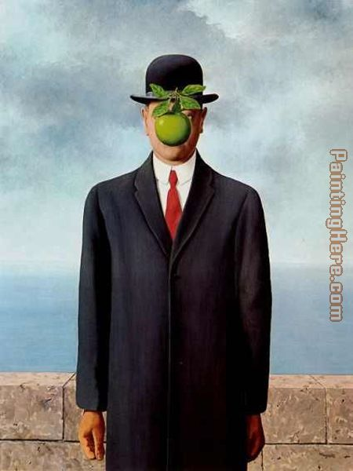
Son of Man— Rene Magritte

Slide 7
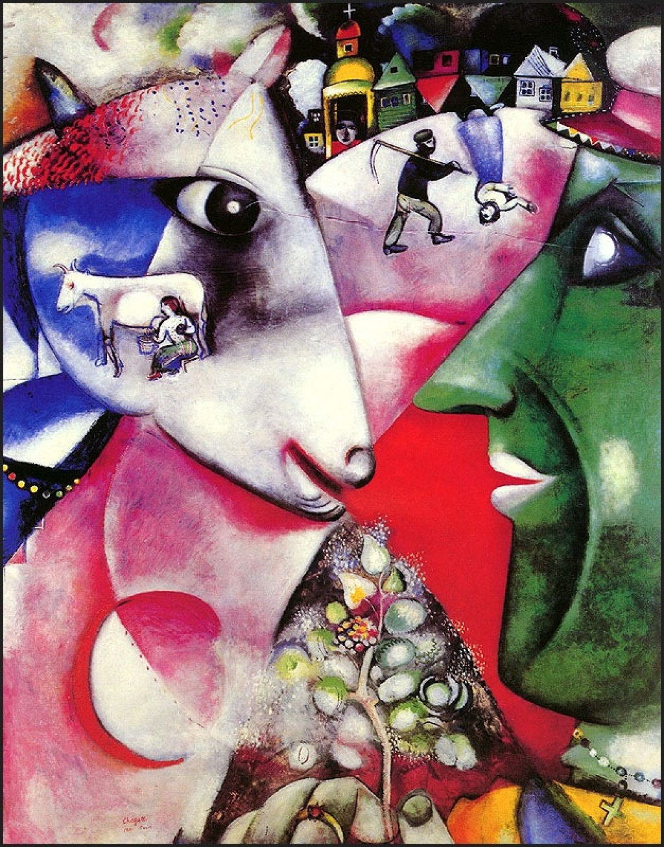
The Village and I—Marc Chagall

Slide 8
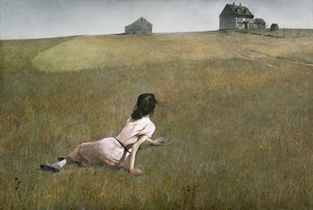
Christina’s World--Andrew Wyeth

