Slide 1
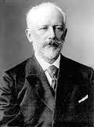
Russian Romantic Composer
Piotr Illitch Tchaïkovsky
Nutcracker
Swan Lake
Sleeping Beauty
1812 Overture

Slide 2
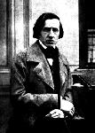
Frédéric Chopin
Polish Romantic
Composer
Famous for Mazurkas,
Piano Sonatas, and Waltzes

Slide 3
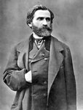
Giuseppe Verdi
Italian Romantic
Oprea Composer
Othello
Adia
Rigoletto
The Four Seasons

Slide 4
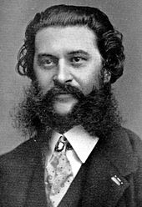
Johann Strauss
Austrian
Romantic Period
Known as the Waltz King
The Blue Danube

Slide 5
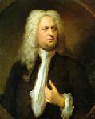
Georg Friedrich Händel
German
Baroque
Messiah
Waterworks
Music for Royal Fireworks

Slide 6
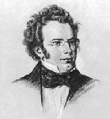
Franz Schubert
Austrian
Romantic
Died at 32
Winterreise
“Trout”
“Death & the Maiden”

Slide 7
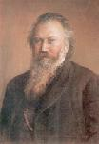
Johannes Brahms
German
Romantic Period
Piano Virtuoso
Lullaby
Requiem

Slide 8
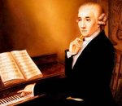
Joseph Haydn
Austrian
Classical
“Father of the Symphony”
“Father of the String Quartet”
The Creation
Sunrise

Slide 9
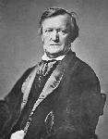
Richard Wagner
German
Wrote Operas
Tristun and Isolade
Lohengrin
The Flying Dutchman
“The Anvil Chorus”

Slide 10
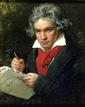
Ludwig van Beethoven
German
Classical/Romantic
Partly Deaf
Symphony #9 in D Minor
Symphony #5 in C Minor

Slide 11
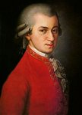
Wolfgang Amadeus Mozart
German
Classical
Died at age 35
Don Giovanni
Marriage of Figaro
The Magic Flute

Slide 12
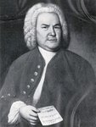
Johann Sebastian Bach
German
Baroque
Organist
Bradenburg Concerto
Mass in B Minor

Slide 13
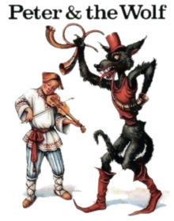
Sergei Prokofiev
Peter—Stringed Instruments
Hunter—Woodwinds/Trumpets
Wolf—French Horns
Bird—Flute
Duck—Oboe
Cat—Clarinet
Grandfather--Bassoon

