Slide 1
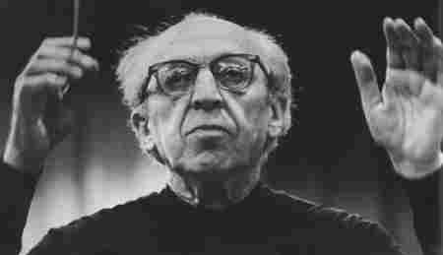
Aaron Copeland
(November 14, 1900 – December 2, 1990) was an American composer,
-- “Appalachian Spring”
-- “Fanfare for the Common Man”
-- “Shenandoah
-- “Billy the Kid”

Slide 2
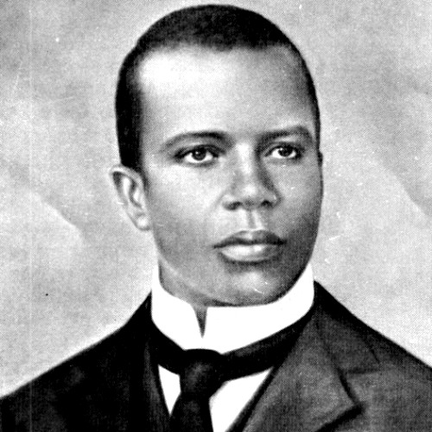
Scott Joplin
1867-1917, African-American pianist
Noted for popularizing “Rag Time”
“The Entertainer”
“The Maple Leaf Rag”

Slide 3
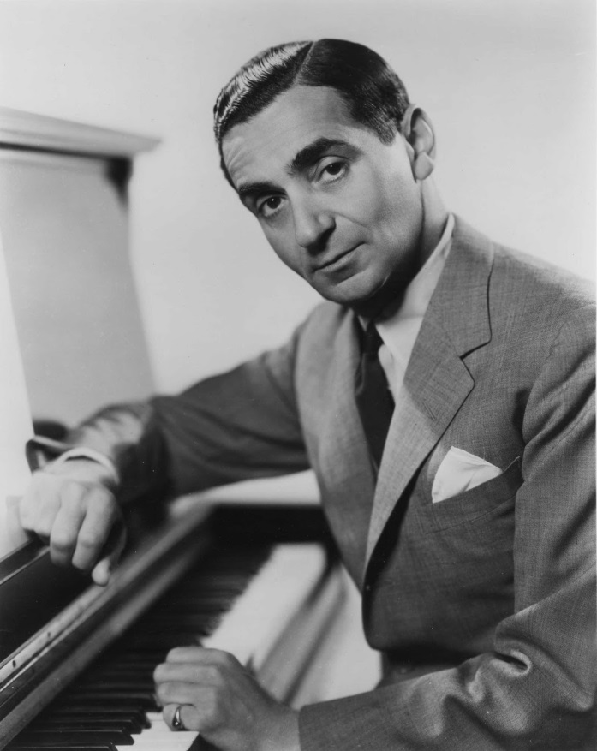
Irving Berlin
May 11, 1888 – September 22, 1989) was a Russian-born Jewish-Americancomposer and lyricist. Widely considered one of the greatest songwriters in American history,
“White Christmas”
“Putting on the Ritz”
“God Bless America”
“Blue Skies”

Slide 4
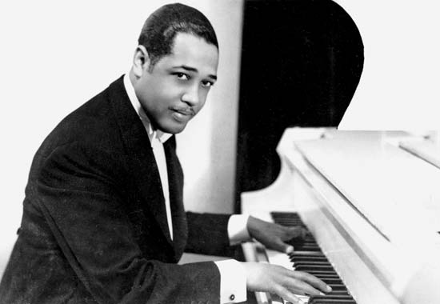
Duke Ellington
(April 29, 1899 – May 24, 1974) was an American composer, pianist and bandleader of jazz orchestras.
“It Don’t Mean a Thing (If It Ain’t Got That
Swing)”
“Satin Doll”
“Take the A Train”
“In a Sentimental Mood”

Slide 5
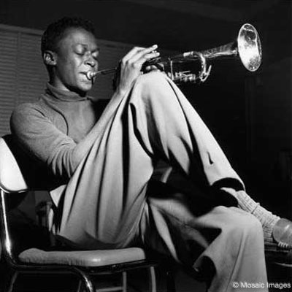
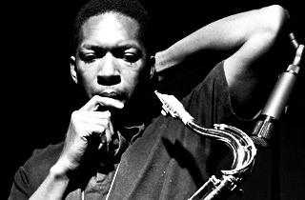
Miles Davis
John Coltrane
(May 26, 1926 – September 28, 1991) was an American jazz musician, trumpeter, bandleader, and composer. Widely considered one of the most influential musicians of the 20th century
(September 23, 1926 – July 17, 1967),^{[1]} was an American jazzsaxophonist and composer.
-- “Blue Train”
-- “A Love Supreme
-- “My Favorite
Things”
--Kind of Blue
--”So What?”
-- “Seven Steps to Heaven”
-- “ESP”

Slide 6
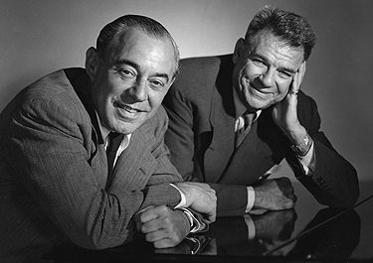
Richard Rodgers & Oscar Hammerstein
(June 28, 1902 – December 30, 1979) was an American composer of music for more than 900 songs and for 43 Broadway musicals.
July 12, 1895 – August 23, 1960) was an Americanlibrettist, theatrical producer, and (usually uncredited) theatre director of musicals for almost forty years.
Songs for the musical Oklahoma!, The Sound of Music, South Pacific, and The King and I

Slide 7
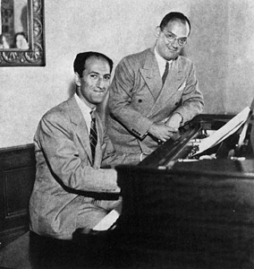
George Gershwin
September 26, 1898 – July 11, 1937) was an American composer and pianist
Wrote many songs with his brother, Ira. Died of brain tumor
Operas Porgy and Bess and Blue Monday
“Rhapsody in Blue”

Slide 8
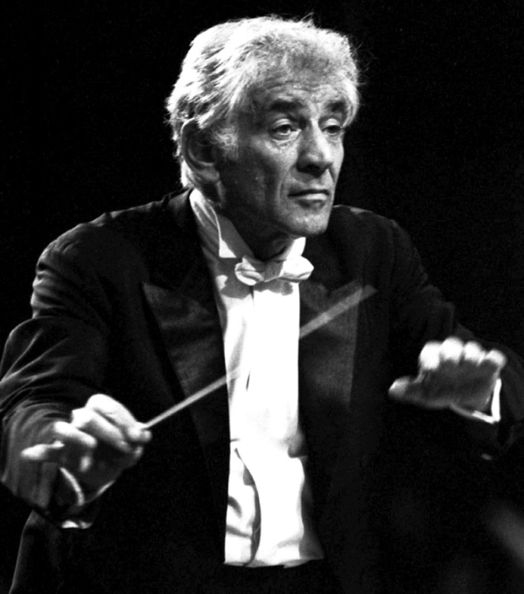
Leonard Bernstein
August 25, 1918 – October 14, 1990) was an American composer, conductor, author, music lecturer, and pianist.
West Side Story (musical, film)
Peter Pan (musical)
On the Waterfront (film)

Slide 9
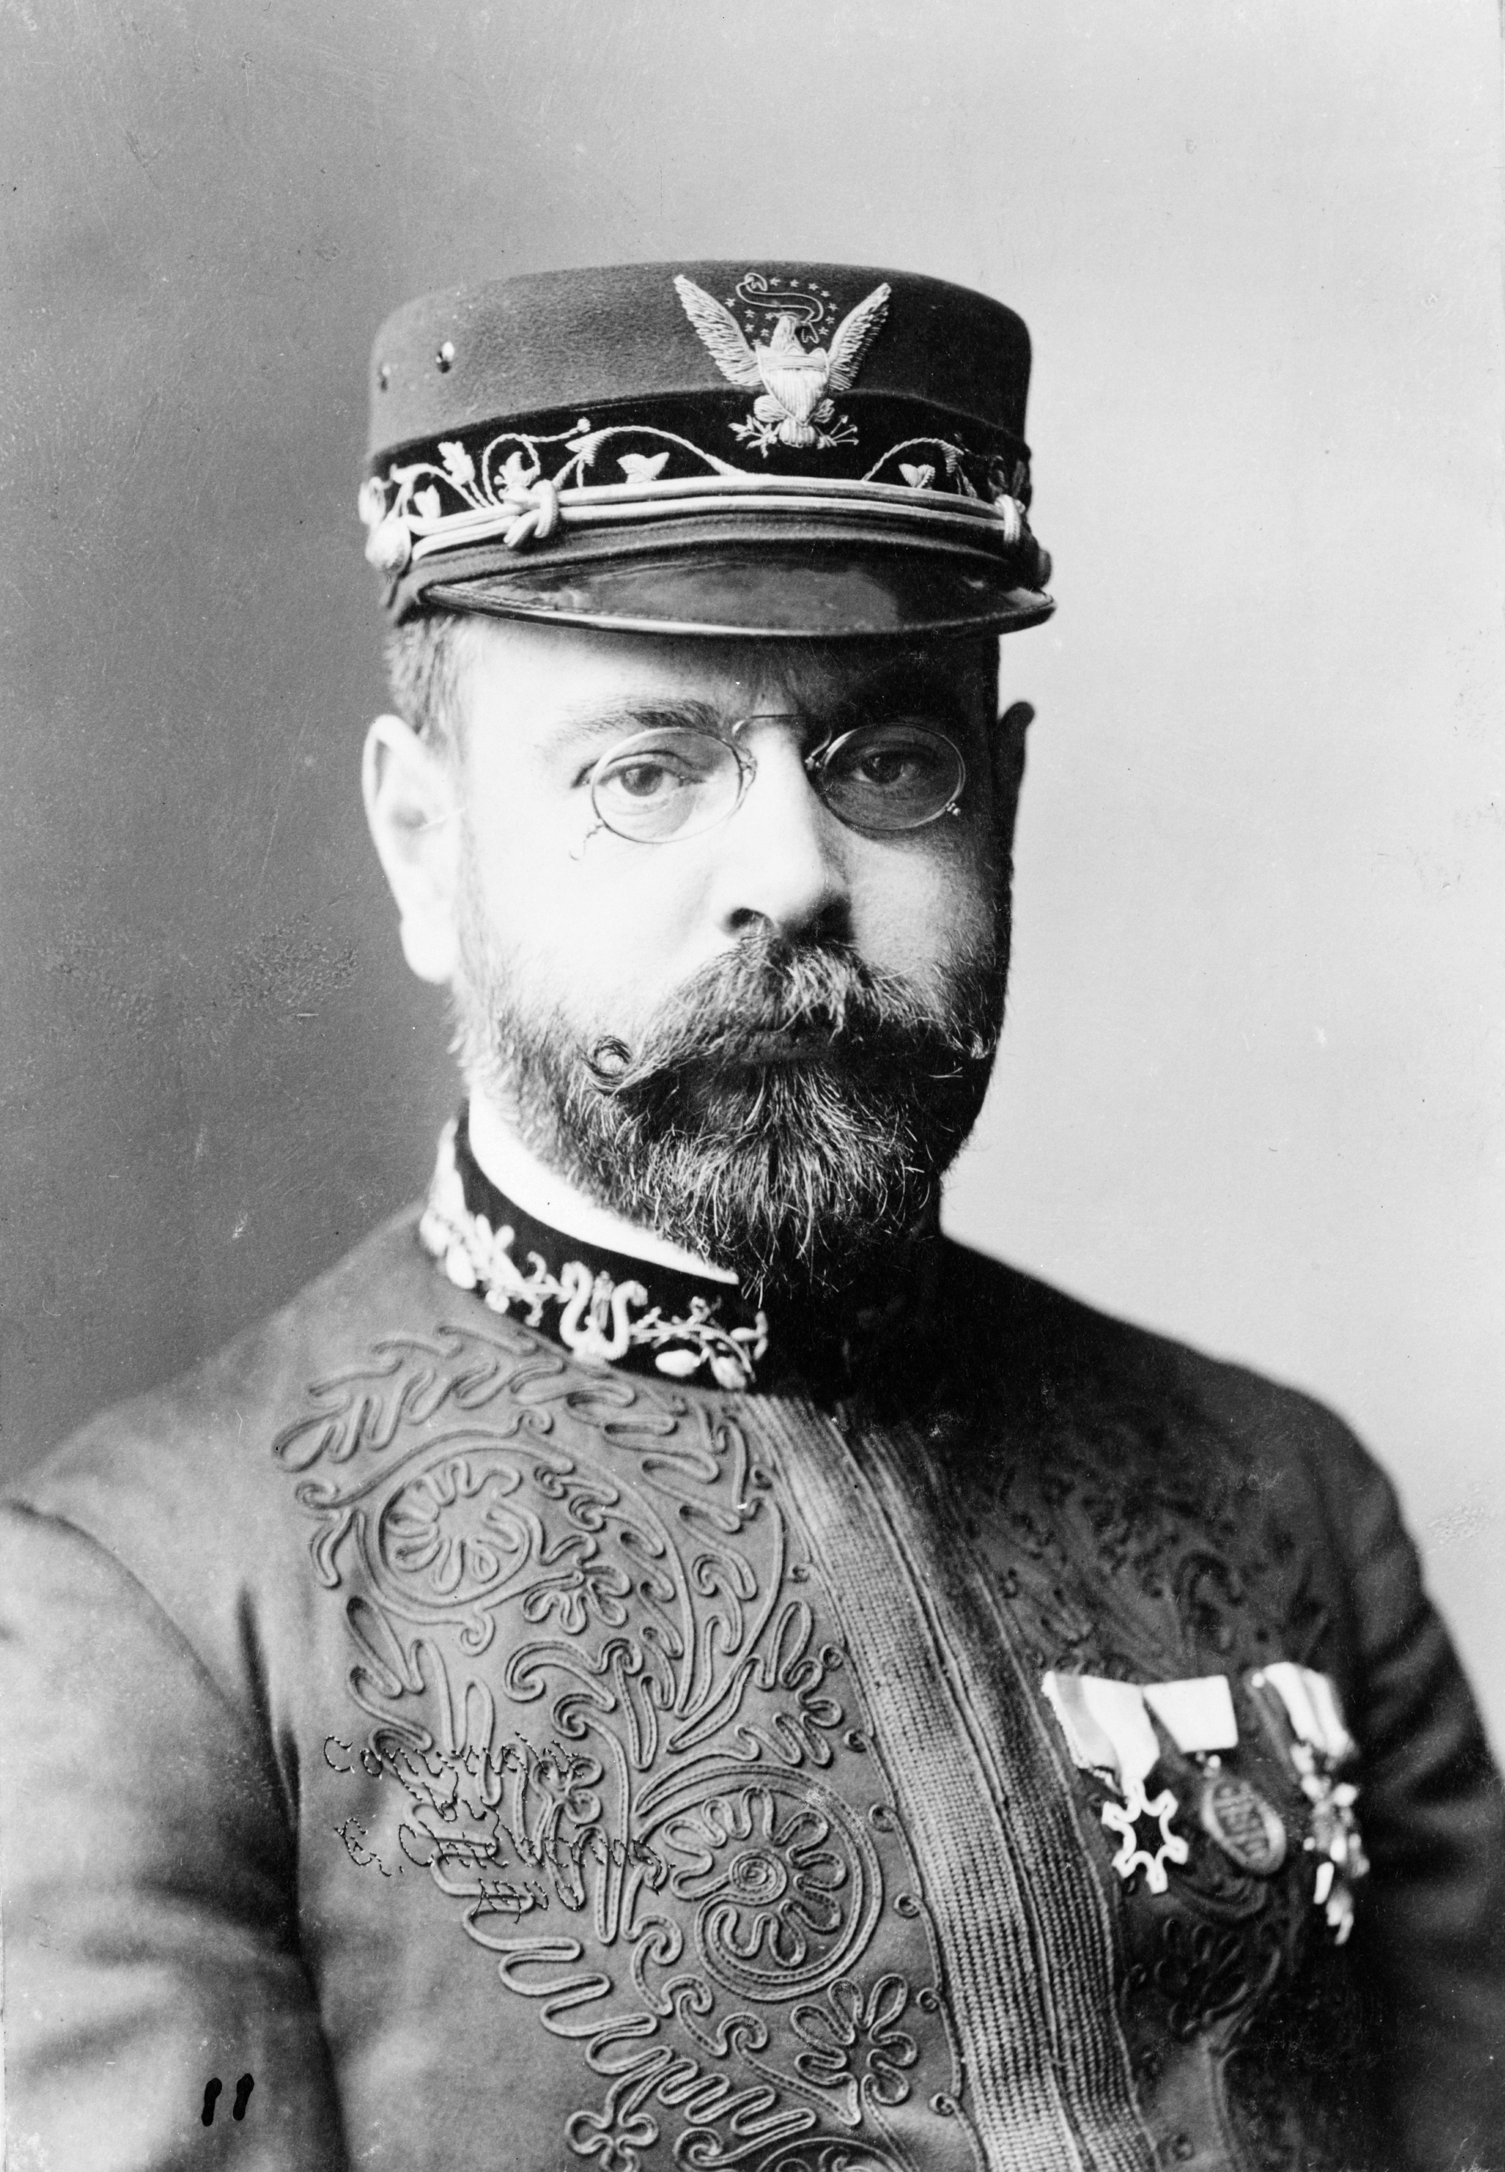
John Philip Sousa
(November 6, 1854 – March 6, 1932) was an American composer and conductor of the late Romantic era, known primarily for American military and patriotic marches. Because of his mastery of march composition, he is known as "The March King"
“Stars and Stripes Forever”
Various military marches

Slide 10
Andrew Lloyd Weber
(born 22 March 1948) is an English composer andimpresario of musical theatre.^{[3]}
Cats
Phantom of the Opera
Jesus Christ Superstar
Joseph and the Amazing
Technicolor Dream Coat
Evita

Slide 11
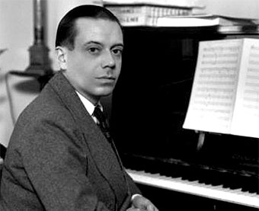
Cole Porter
(June 9, 1891 – October 15, 1964) was an American composer and songwriter.
“I Get a Kick out of You”
“Anything Goes”
“De-lovely”
“Under My Skin”
Kiss Me Kate

Slide 12
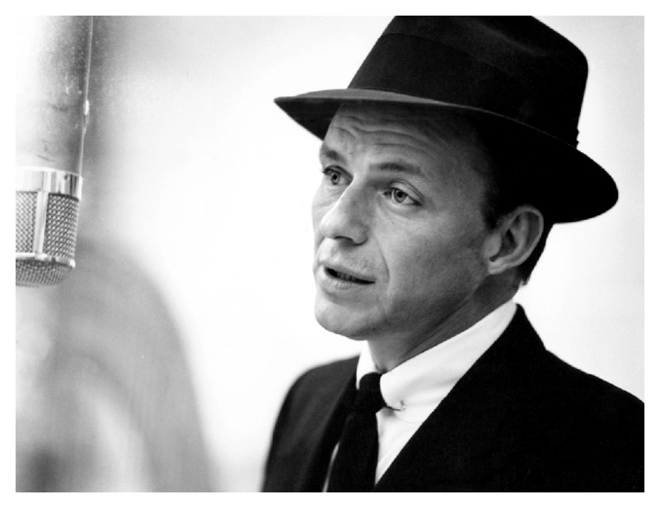
Frank Sinatra
December 12, 1915 – May 14, 1998^{[3]}) was an American singer, actor, director, and producer.
Known as “Old Blue Eyes” and “Chairman of the Board”
Famous songs include
“I’ve Got You Under My Skin”
“Come Fly with Me”
“New York, New York”

Slide 13
Synopses of Musicals
My Fair Lady
The King and I
Cats
Oklahoma
Phantom of the Opera
Joseph and the Amazing Technicolor Dream Coat
West Side Story
Hello Dolly
Carousel
Les Miserables
Fiddler on the Roof
The Sound of Music

Slide 14
West Side Story music by Leonard Bernstein
West Side Story is the award-winning adaptation of the classic romantic tragedy, "Romeo and Juliet". The feuding families become two warring New York City gangs- the white Jets led by Riff and the Puerto Rican Sharks, led by Bernardo. Their hatred escalates to a point where neither can coexist with any form of understanding. But when Riff's best friend (and former Jet) Tony and Bernardo's younger sister Maria meet at a dance, no one can do anything to stop their love. Maria and Tony begin meeting in secret, planning to run away. Then the Sharks and Jets plan a rumble under the highway - whoever wins gains control of the streets. Maria sends Tony to stop it, hoping it can end the violence. It goes terribly wrong, and before the lovers know what's happened, tragedy strikes and doesn't stop until the climactic and heartbreaking ending.

