Slide 1
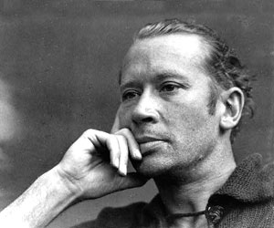
E. E. Cummings
(October 14, 1894 – September 3, 1962)
--known for his unusual way of
Writing poems
-- “anyone lived in a pretty how town”
maggie and milly and molly and may went down to the beach(to play one day) and maggie discovered a shell that sang so sweetly she couldn't remember her troubles,and milly befriended a stranded star whose rays five languid fingers were; and molly was chased by a horrible thing which raced sideways while blowing bubbles:and may came home with a smooth round stone as small as a world and as large as alone. For whatever we lose(like a you or a me) it's always ourselves we find in the sea
l(a le af fa ll s) one l iness

Slide 2
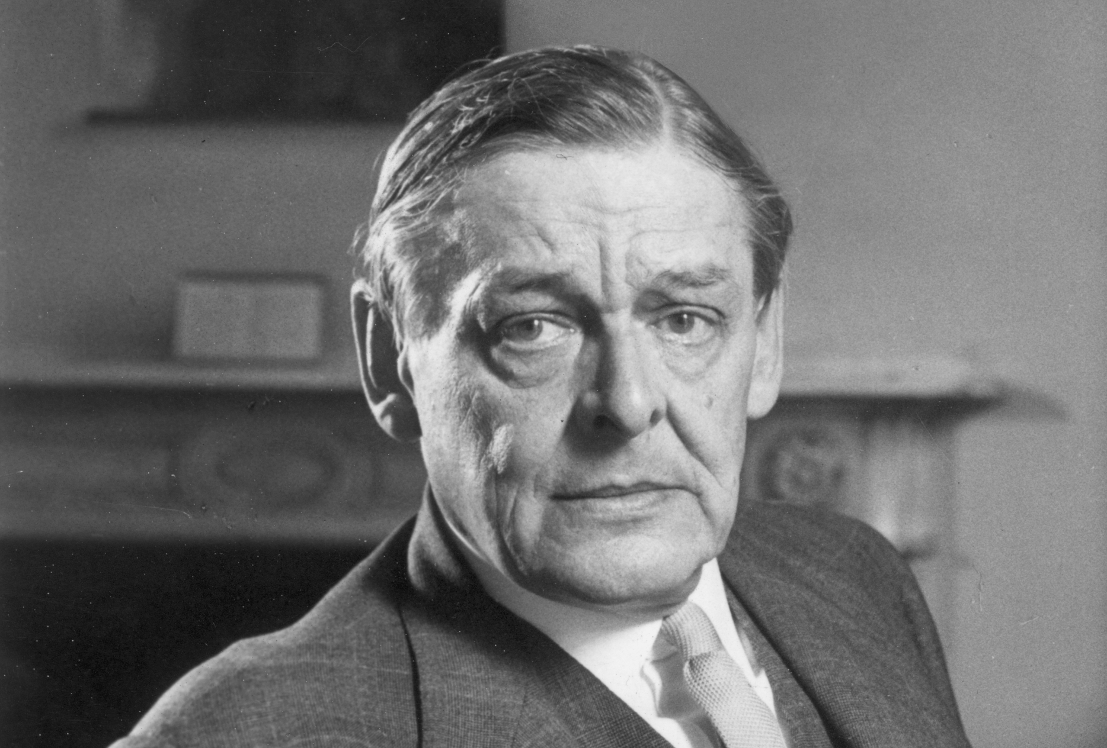
T. S. Elliot
(26 September 1888 – 4 January 1965)
--Well-known poems include
“The Wasteland” and “The Lovesong
of J. Alfred Prufrock
--Poet of “the lost generation”
After WWI
Let us go then, you and I,
When the evening is spread out against the sky
Like a patient etherized upon a table;
Let us go, through certain half-deserted streets,
The muttering retreats
Of restless nights in one-night cheap hotels
And sawdust restaurants with oyster-shells:
Streets that follow like a tedious argument
Of insidious intent
To lead you to an overwhelming question ...
Oh, do not ask, “What is it?”
Let us go and make our visit.

Slide 3
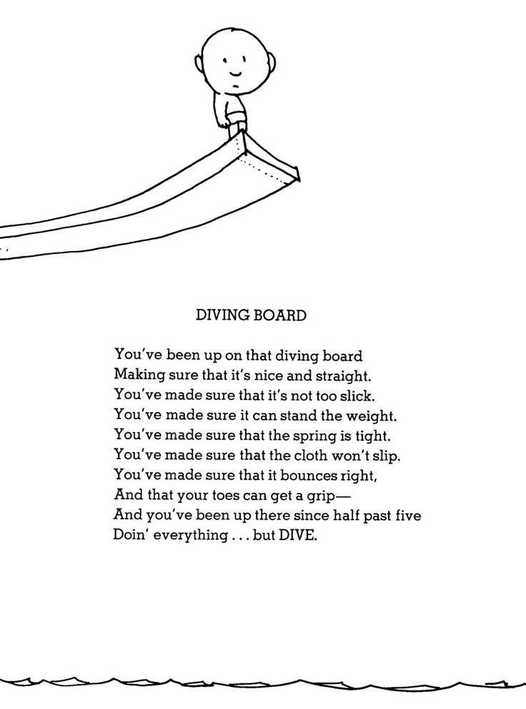
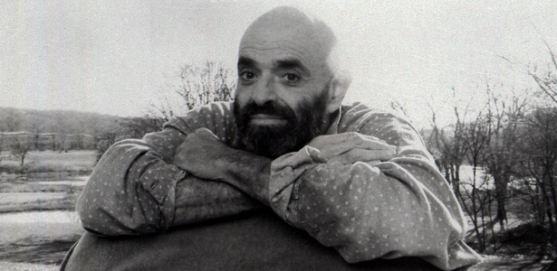
Shel Silverstein
September 25, 1930 – May 10, 1999)
--poet, songwriter well-
Known for his books of silly
Children’s poetry
--A Light in the Attic
--Where the Sidewalk Ends
--Falling Up

Slide 4
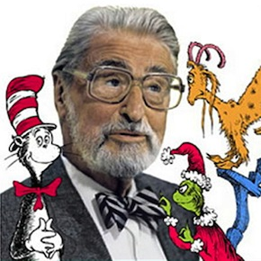
Dr. Suess
Theodor Seuss Geisel
( March 2, 1904 – September 24, 1991)
--known for rhyming children’s books.
--The Grinch Who Stole Christmas
--The Lorax
--One Fish, Two Fish, Red Fish, Blue Fish
--The Cat in the Hat
--Green Eggs and Ham

Slide 5
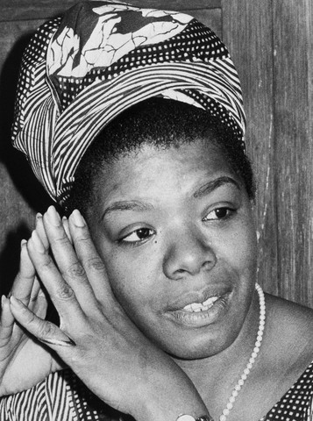
Maya Angelou
born Marguerite Annie Johnson; April 4, 1928 – May 28, 2014)
--Wrote I Know Why the Caged
Bird Sings, an autobiography about
her childhood.
--Poet Laureate for Pres. Bill Clinton
“On the Pulse of the Morning” read
at inauguration.

Slide 6
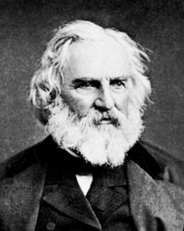
Henry Wadsworth Longfellow
(February 27, 1807 – March 24, 1882)
--Considered one of the “Fireside Poets”
-- “The Midnight Ride of Paul Revere”
-- “The Song of Hiawatha”
-- “Evangeline”

Slide 7
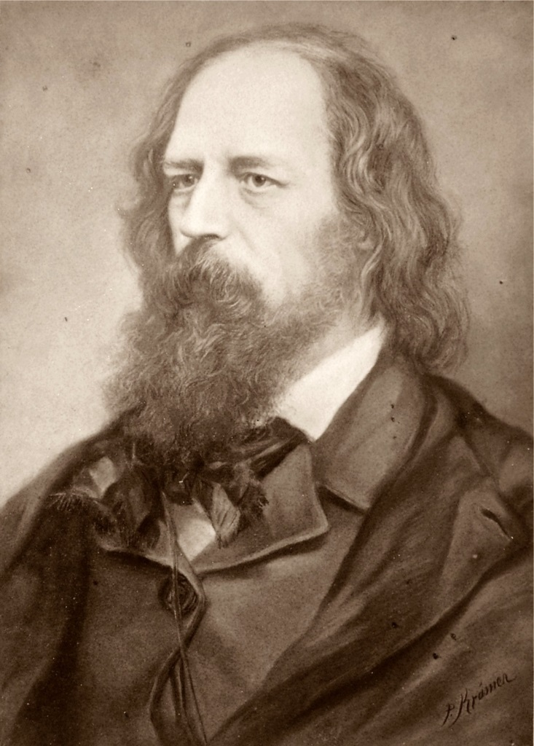
Lord Alfred Tennyson
(6 August 1809 – 6 October 1892) was Poet Laureate of Great Britain and Ireland during much of Queen Victoria's reign and remains one of the most popular British poets.
--His most famous poem is
“The Charge of the Light Brigade,”
about a group of British soldiers in
the Crimean War who charged into battle
despite being outnumbered.
I
Half a league, half a league,
Half a league onward,
All in the valley of Death
Rode the six hundred.
“Forward, the Light Brigade!
Charge for the guns!” he said.
Into the valley of Death
Rode the six hundred.

Slide 8
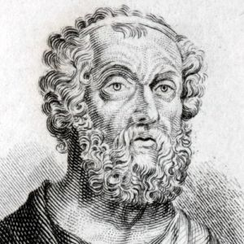
Homer
Greek poet, blind, who orally recited
Epic poems, town-to-town.
He’s credited with composing both
The Iliad (about the Trojan War) and
The Odyssey (about Odysseus’ trip back from the war)

Slide 9
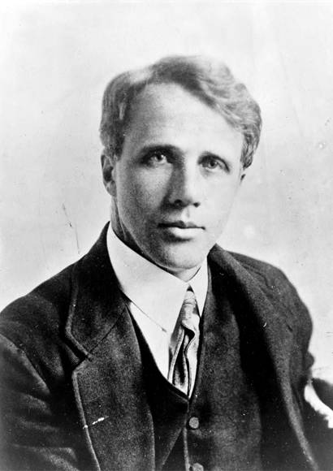
Robert Frost
Robert Lee Frost (March 26, 1874 – January 29, 1963)
--Known for his depictions of rural
New England life
--Poet Laureate for JFK
-- “The Road Not Taken”
-- “The Mending Wall”
-- “Nothing Gold Can Stay”
-- “Stopping by Woods on a
Snowy Evening”

Slide 10
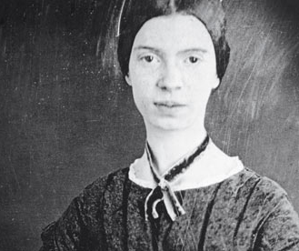
Emily Dickenson
(December 10, 1830 – May 15, 1886)
--Most famous American woman
poet, virtually unknown during her
lifetime. She was a recluse living in
her sister’s attic. Critics dismissed
her work for her use of slant rhyme.
-- “I Heard a Fly Buzz When I Died”
-- “Hope Is a Thing with Feathers”
-- “Because I Could Not Stop for Death”

Slide 11
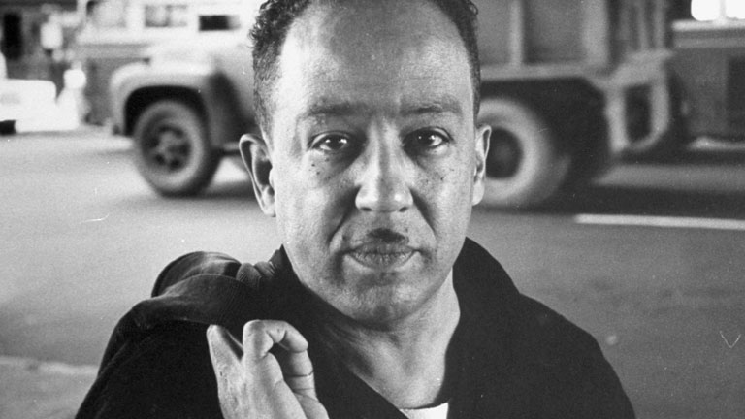
Langston Hughes
(February 1, 1902 – May 22, 1967) was an American poet, social activist, novelist, playwright, and columnist.
--Early innovator of “jazz poetry”
--One of the leading figures of the
Harlem Renaissance
--Famous poems include:
-- “A Dream Deferred” -- “Theme for English B”
-- “The Weary Blues”
-- “The Negro Speaks of Rivers”
What happens to a dream deferred?
Does it dry up like a raisin in the sun? Or fester like a sore-- And then run? Does it stink like rotten meat? Or crust and sugar over-- like a syrupy sweet?
Maybe it just sags like a heavy load.
Or does it explode?

Slide 12
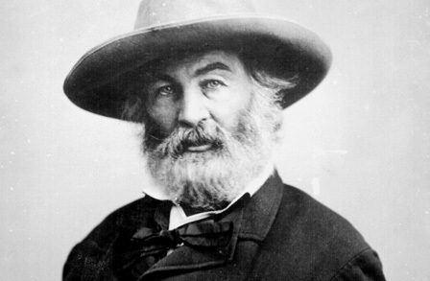
Walt Whitman
--American poet known for his
use of Free Verse (basically, poetry
that didn’t rhyme)
-- His famous book of poems is
entitled Leaves of Grass
--Famous poems include “Song of Myself” and “O Captain! My Captain! (which was about the
Assassination of Abraham Lincoln)
(May 31, 1819 – March 26, 1892)
O Captain! my Captain! our fearful trip is done,
The ship has weather’d every rack, the prize we sought is won,
The port is near, the bells I hear, the people all exulting,
While follow eyes the steady keel, the vessel grim and daring;
But O heart! heart! heart!
O the bleeding drops of red,
Where on the deck my Captain lies,
Fallen cold and dead.

Slide 13
Oliver Wendell Holmes

Slide 14
Edgar Allen Poe

Slide 15
Carl Sandburg

Slide 16
Edgar Lee Masters

Slide 17
William Carlos Williams

Slide 18
Slyvia Plath

Slide 19
Anne Bradstreet

Slide 20
W. B. Yeats

Slide 21
William Shakespeare

